Slide 1
Information management foundations training video

Slide 2
Good information management practices directly benefit the work you do and help you meet your legal obligations

Slide 3
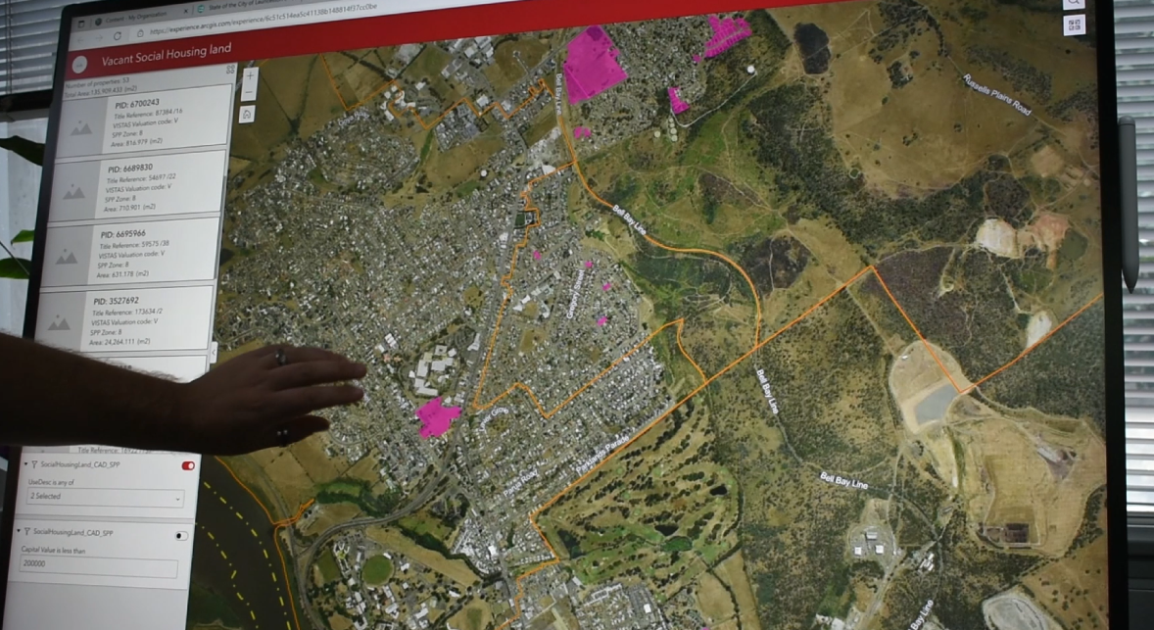
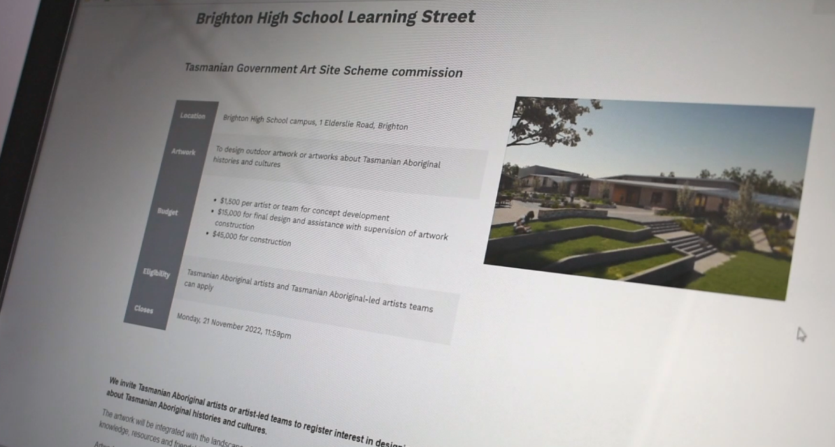
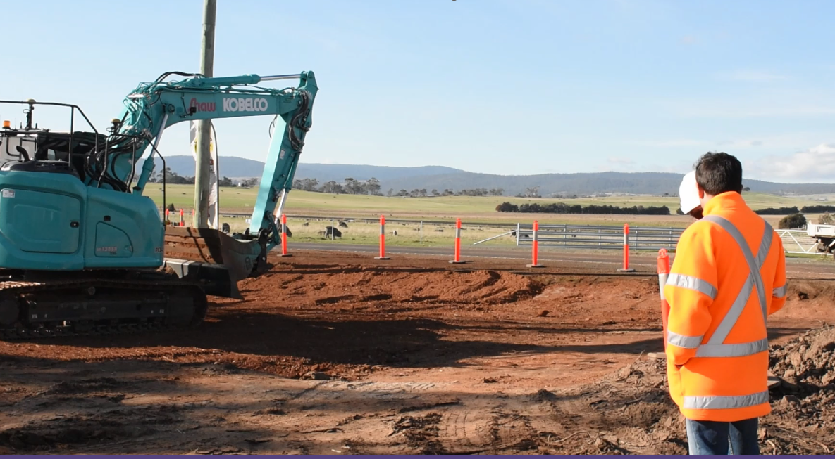
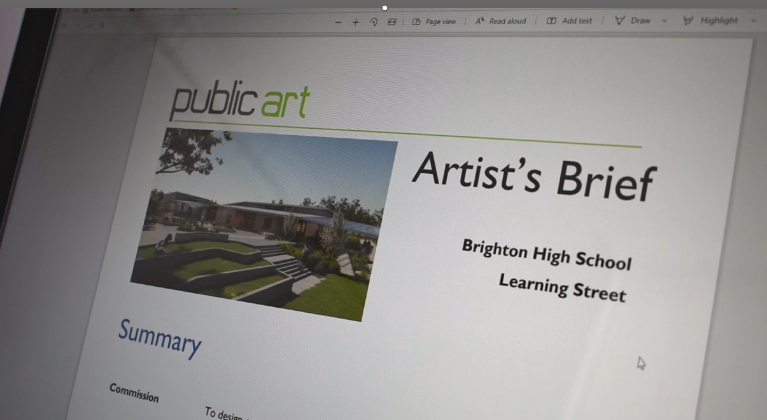
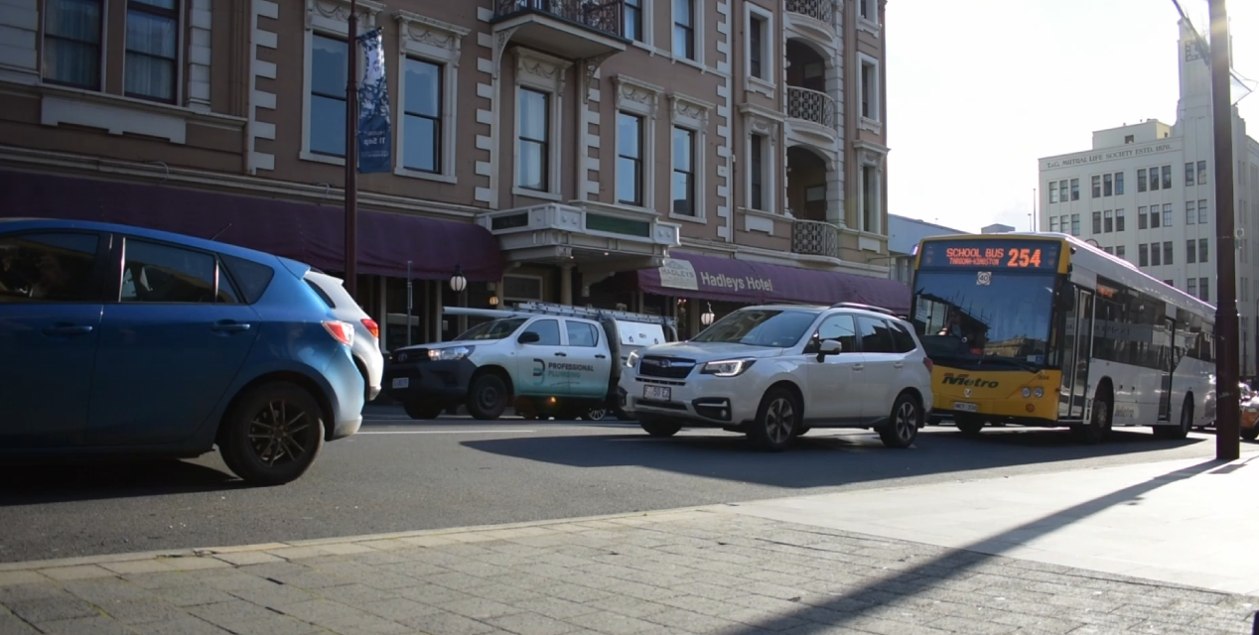

Slide 4
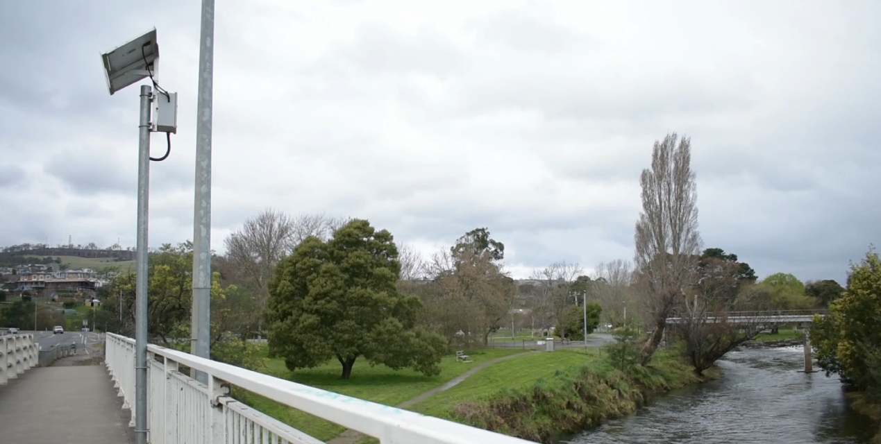
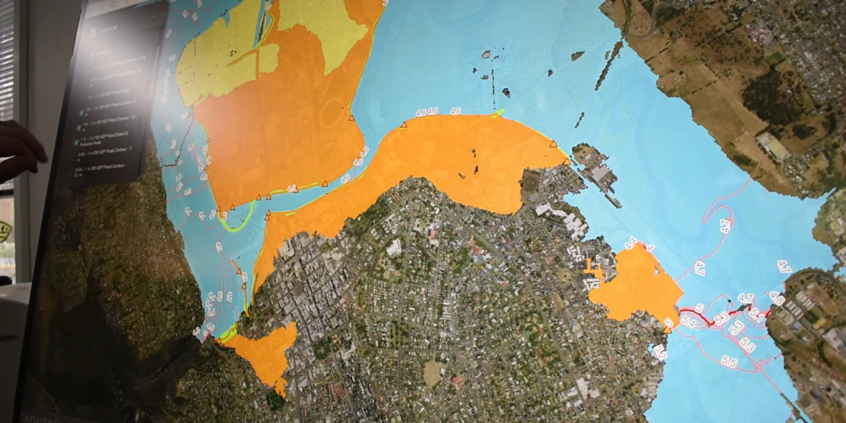
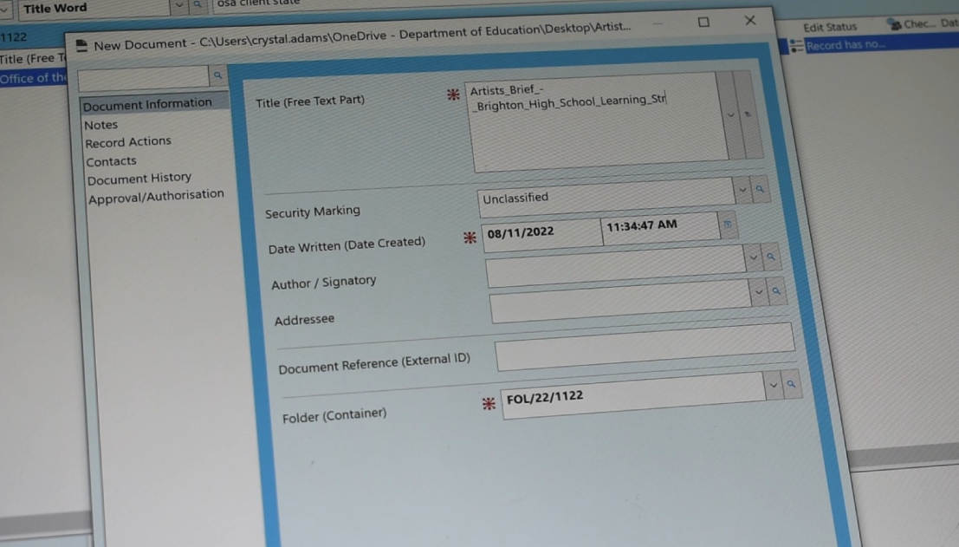
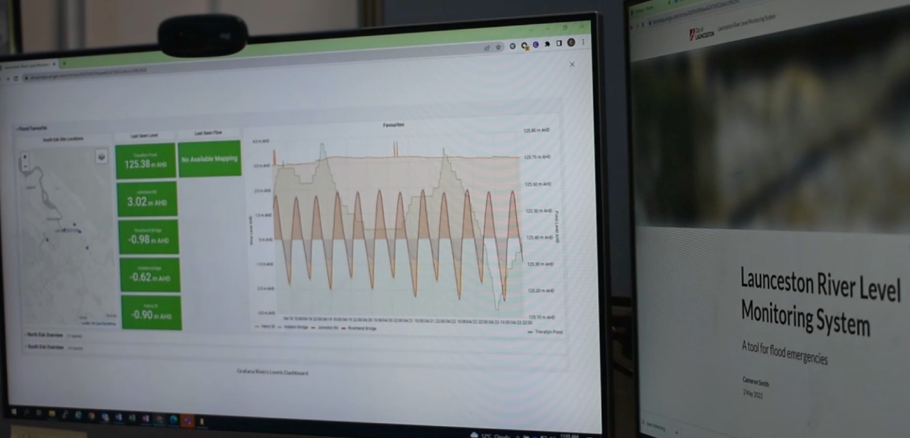

Slide 5
Records tell us what, where, and when something was done, why a decision was made, and who was involved

Slide 6
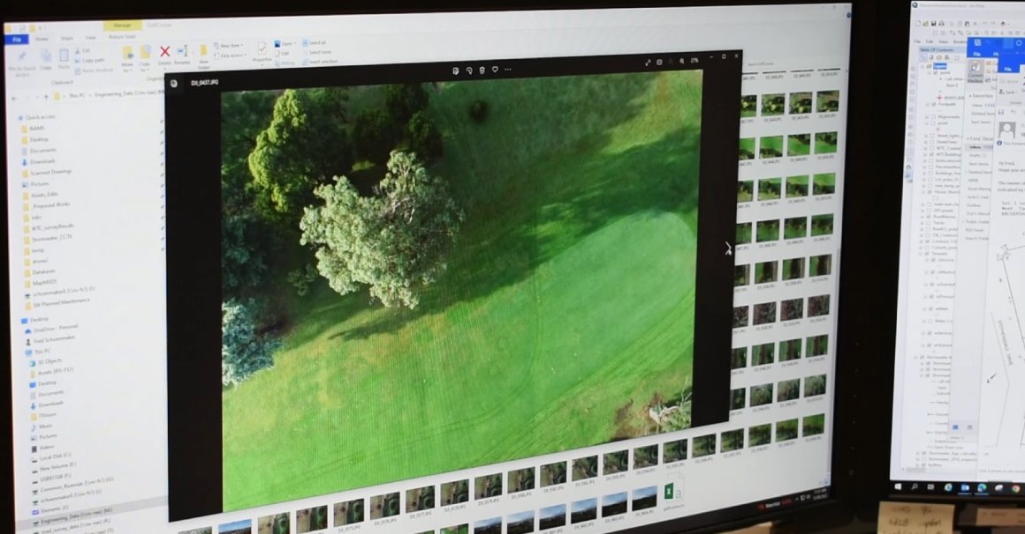
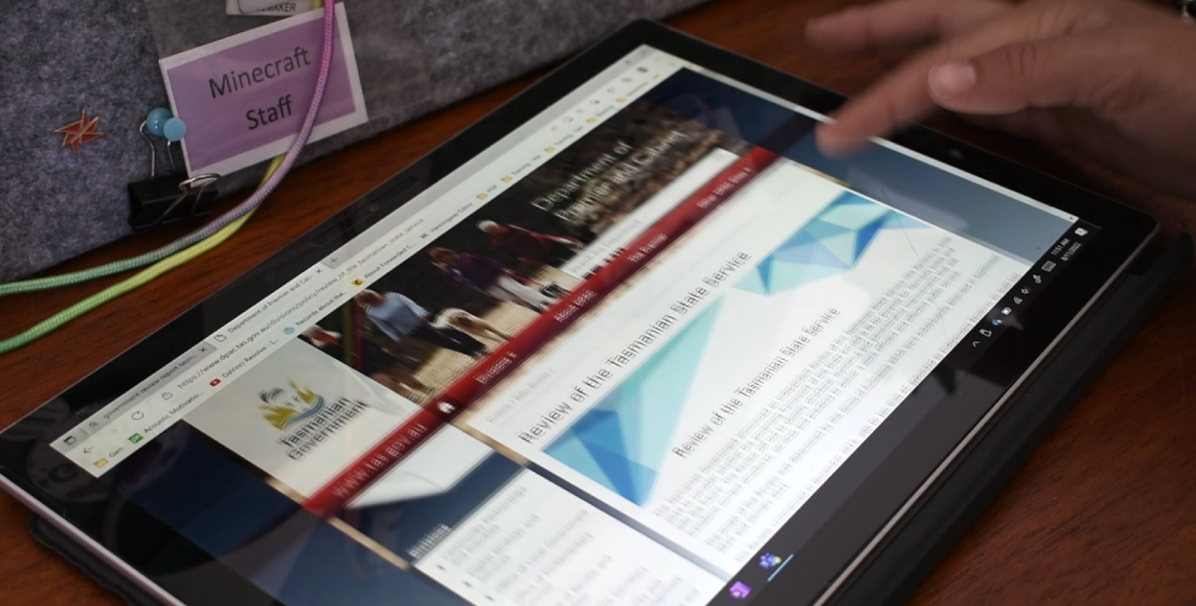
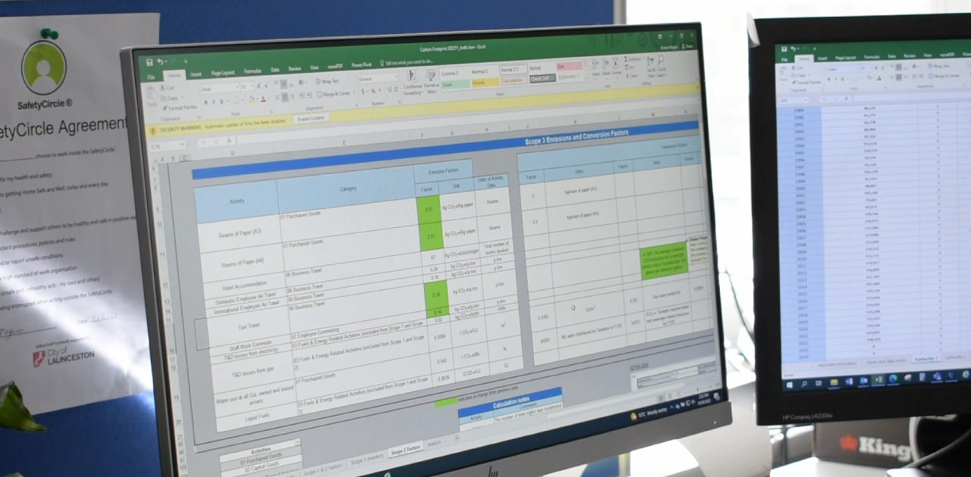
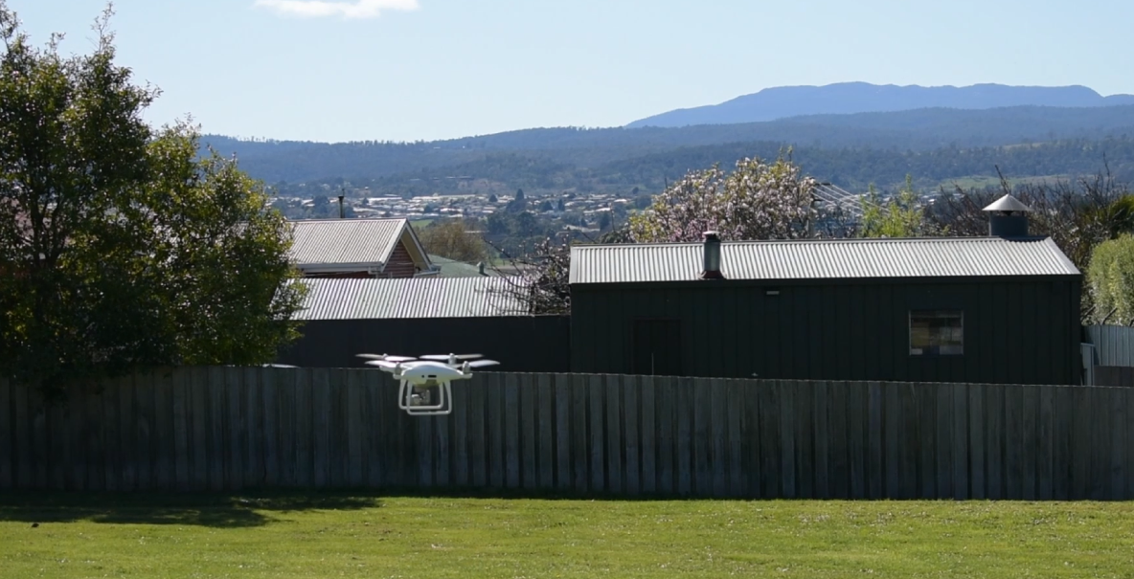
What is information management?

Slide 7
What are some of the more unusual records you have worked with?

Slide 8
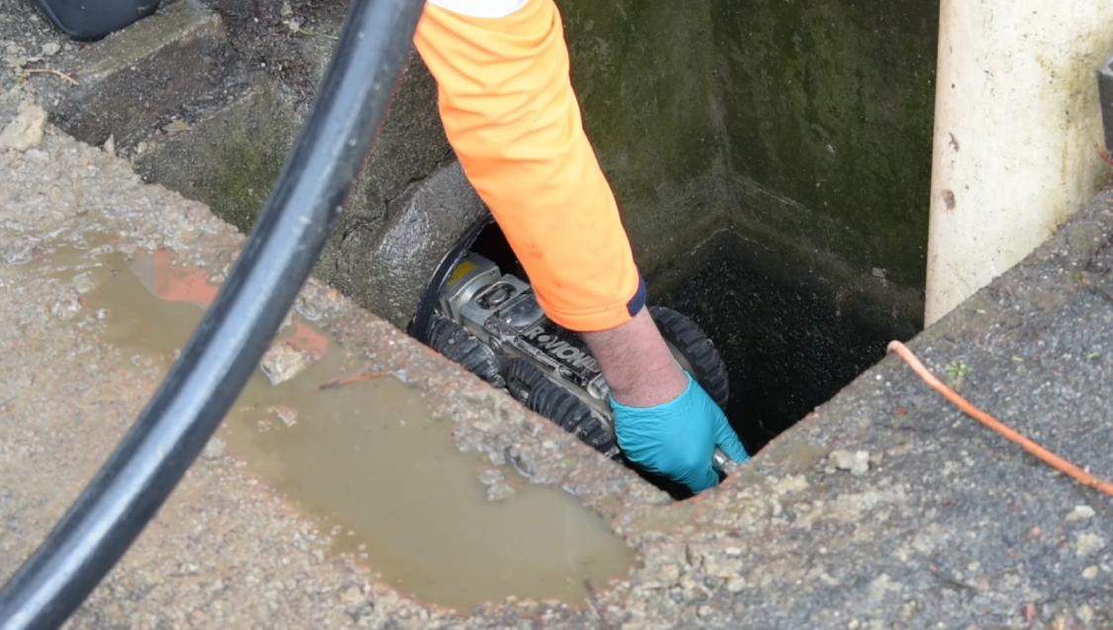
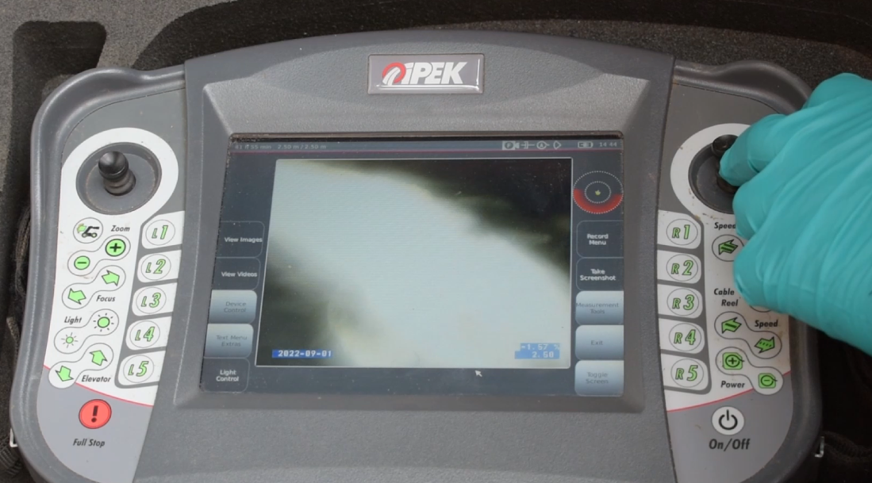
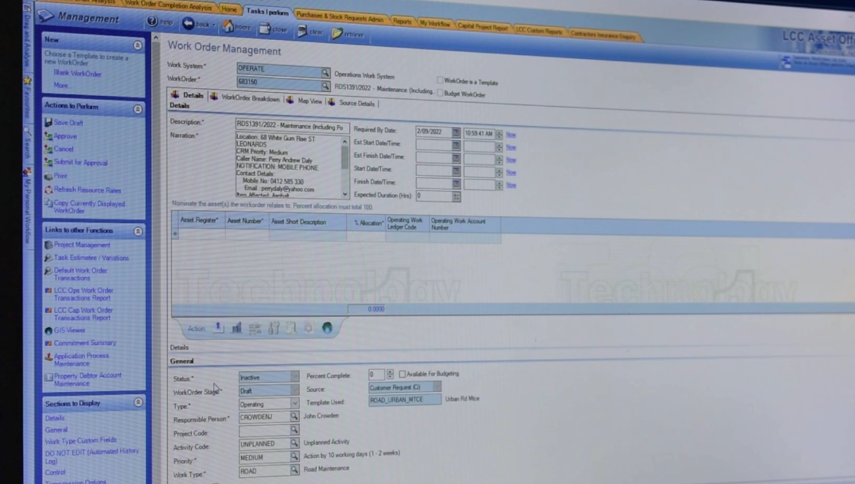
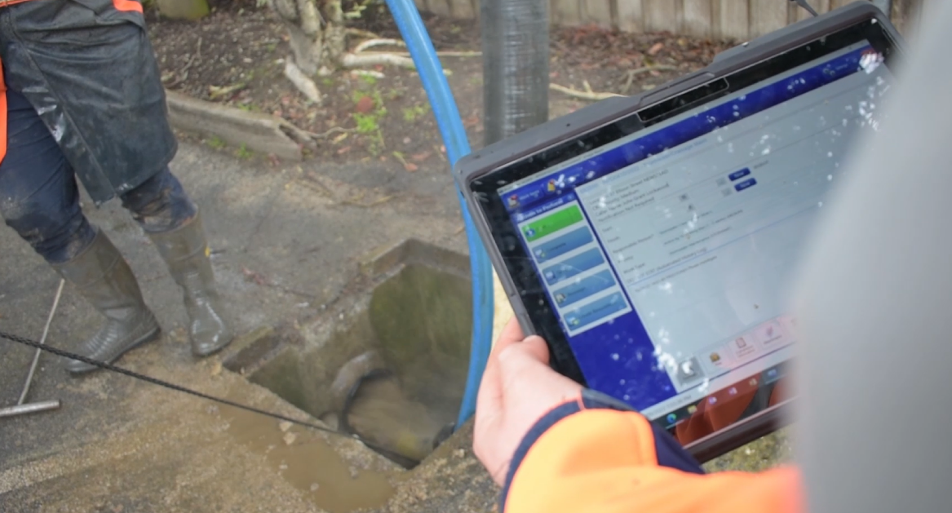
Your responsibilities

Slide 9
Did I write, send or use this in the course of my work?
Make or keep a record:
Am I (or is someone else) required to act on this?
Will this information be needed in the future?

Slide 10
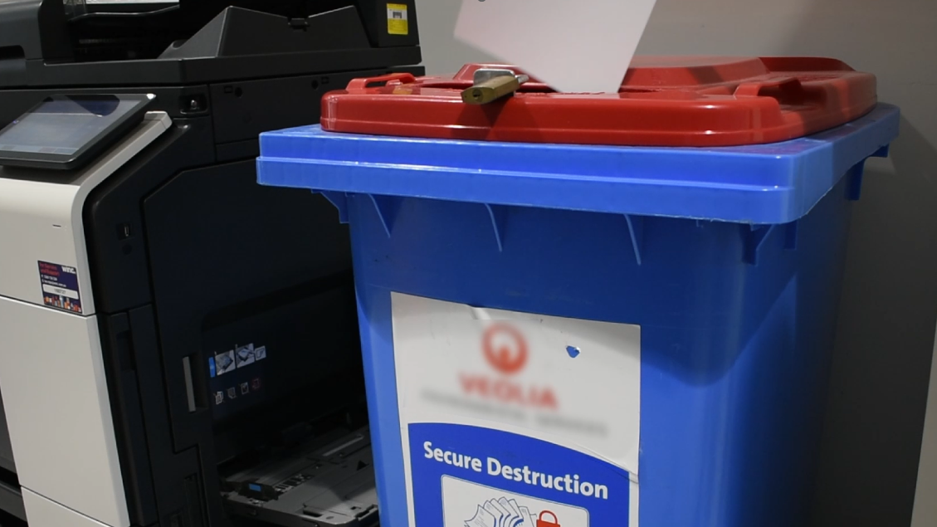
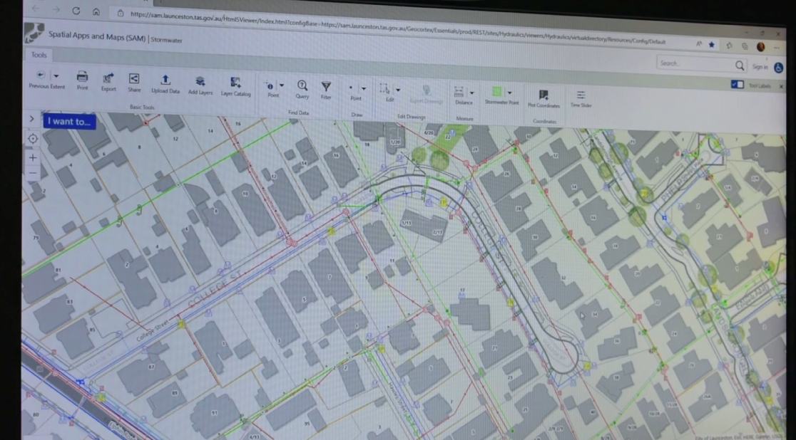
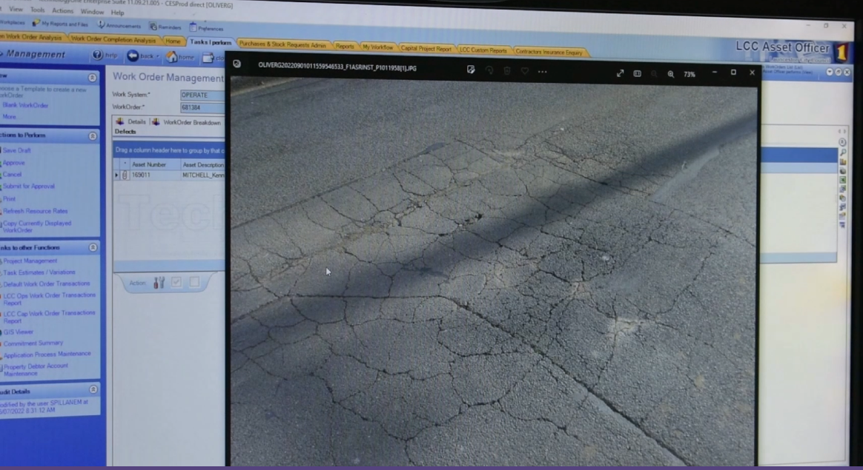
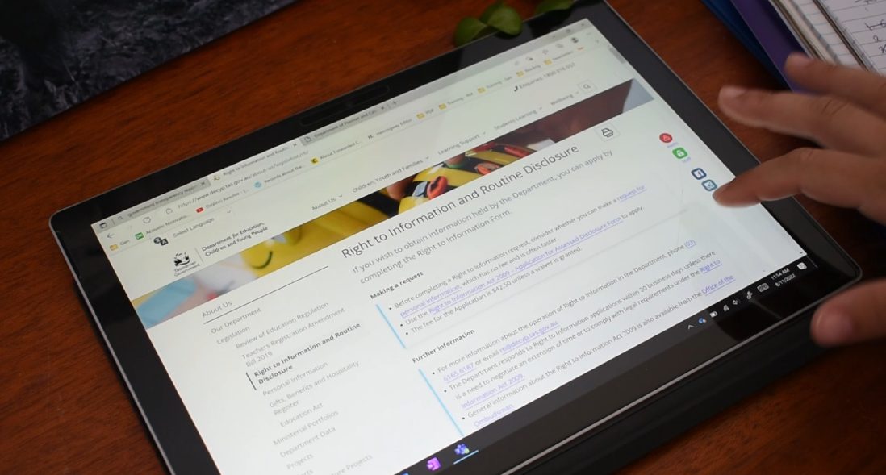
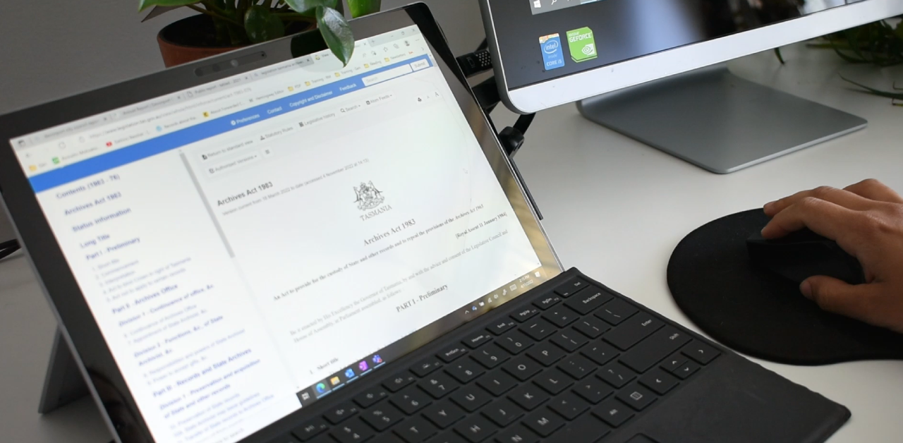
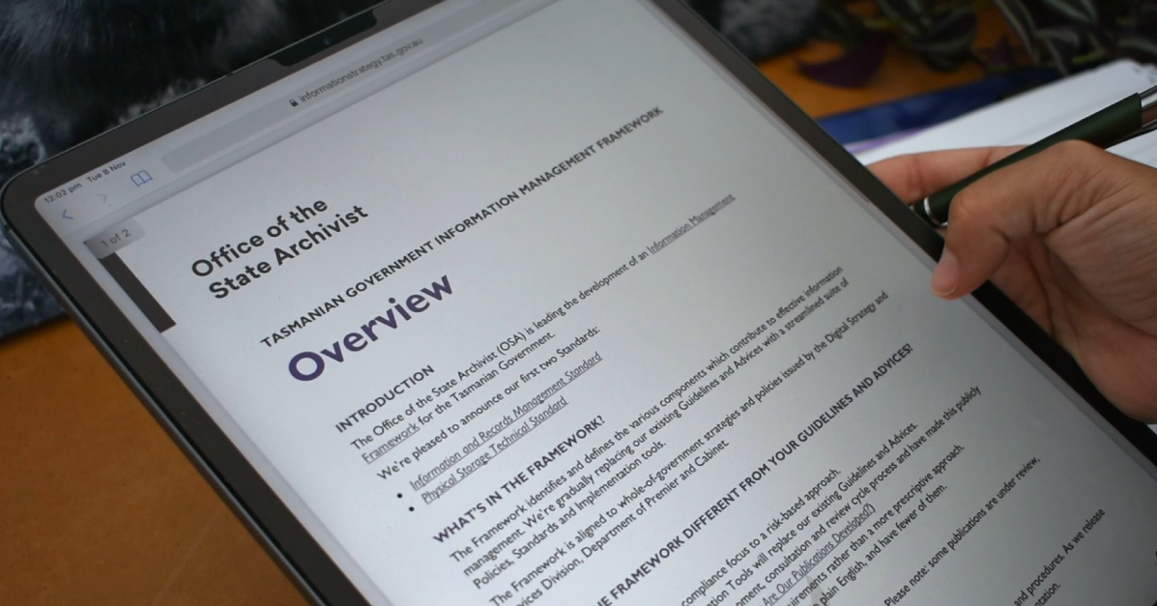
legislation

Slide 11
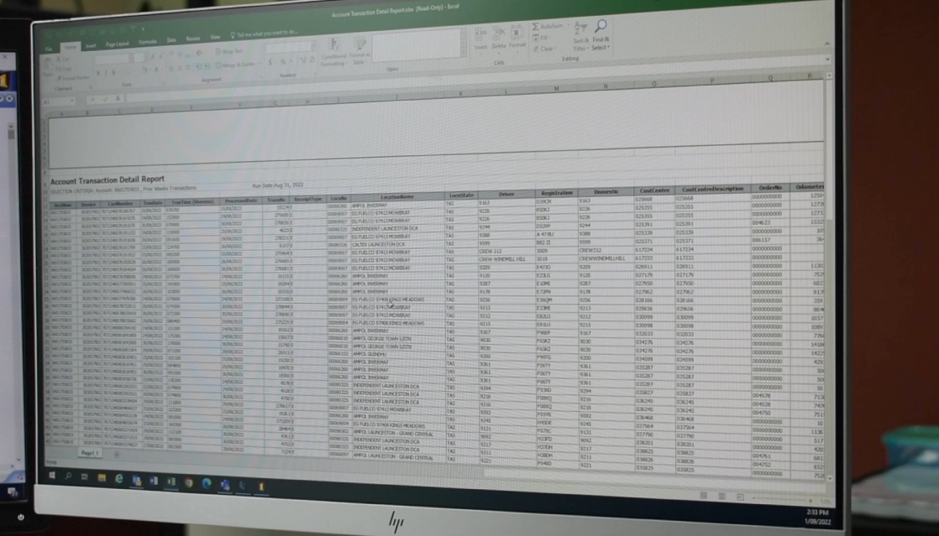
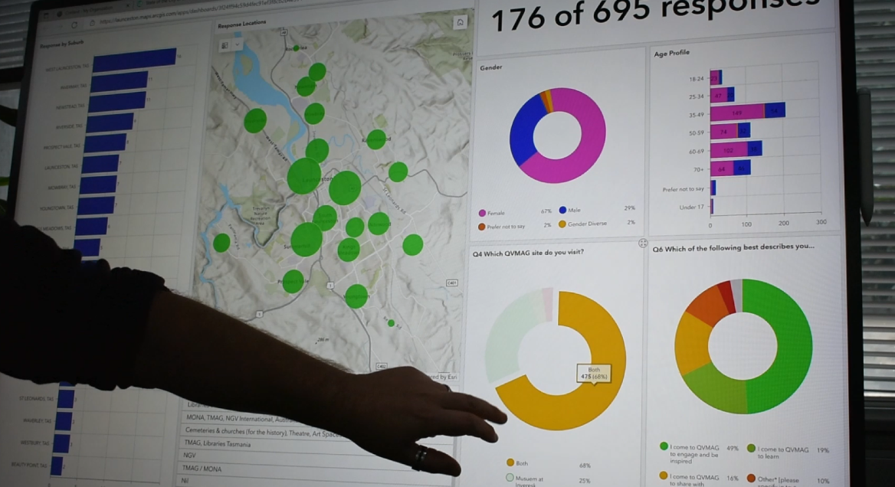
Information management practices

Slide 12
Keeping records routinely as part of your work
Good information practices:
Filing records into your organisations approved records systems
Following your organisations policies and procedures for managing records

Slide 13
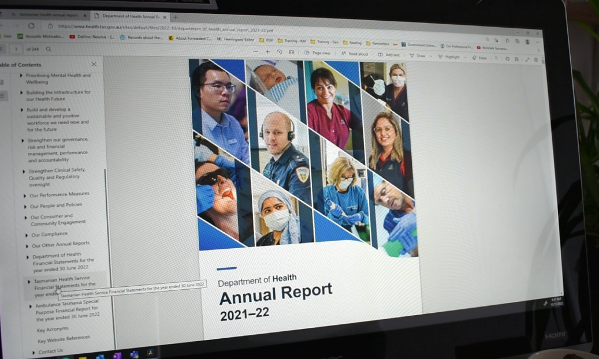
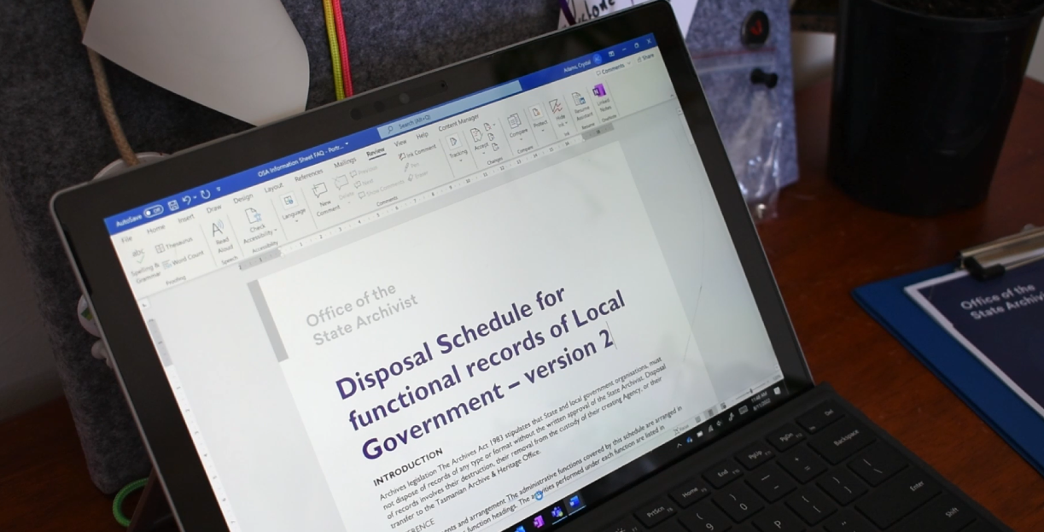
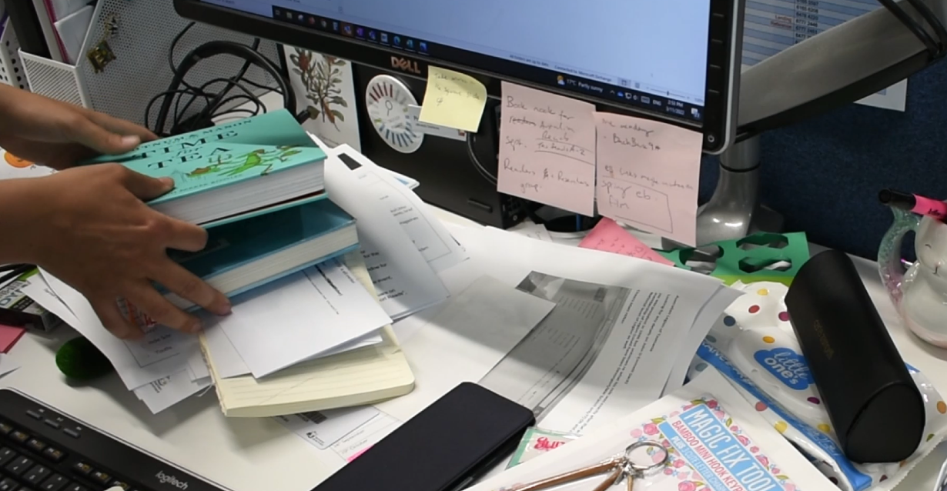
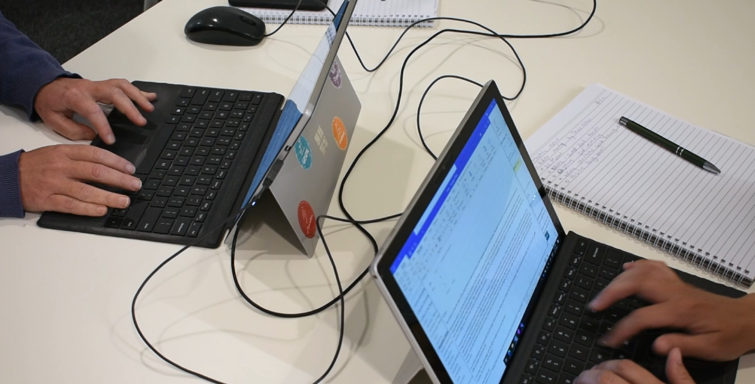
Information management practices

Slide 14
HOSPITAL INFORMATION NEGLECT
MAN DIES IN HOSPITAL AFTER BEING GIVEN MEDICATION HE WAS ALLERGIC TO
CHILDREN NOT PROTECTED
CHILD PROTECTION DATABASE MISSING HUNDREDS OF CHILDREN’S ADDRESSES, REVIEW FINDS
MANUFACTURER FAILED TO KEEP RECORDS OF EMISSIONS COMPLIANCE
RECORDKEEPING FAILURE
TRAVEL BAN EXPIRY ON ‘BAFFLING’, AS POOR RECORD KEEPING EXPOSED IN COURT FIGHT
MAJOR CITY FAILURE
MAN LOSES USB STICK WITH ENTIRE CITY'S PERSONAL DETAILS
AUTHORITIES KNEW
SUSPECTED SHOOTER HAD RECEIVED WARNING LETTER OVER MISSING GUN INVENTORY

Slide 15
HOSPITAL INFORMATION NEGLECT
MAN DIES IN HOSPITAL AFTER BEING GIVEN MEDICATION HE WAS ALLERGIC TO
CHILDREN NOT PROTECTED
CHILD PROTECTION DATABASE MISSING HUNDREDS OF CHILDREN’S ADDRESSES, REVIEW FINDS
MANUFACTURER FAILED TO KEEP RECORDS OF EMISSIONS COMPLIANCE
RECORDKEEPING FAILURE
TRAVEL BAN EXPIRY ON ‘BAFFLING’, AS POOR RECORD KEEPING EXPOSED IN COURT FIGHT
AUTHORITIES KNEW
SUSPECTED SHOOTER HAD RECEIVED WARNING LETTER OVER MISSING GUN INVENTORY
MAJOR CITY FAILURE
MAN LOSES USB STICK WITH ENTIRE CITY'S PERSONAL DETAILS

Slide 16
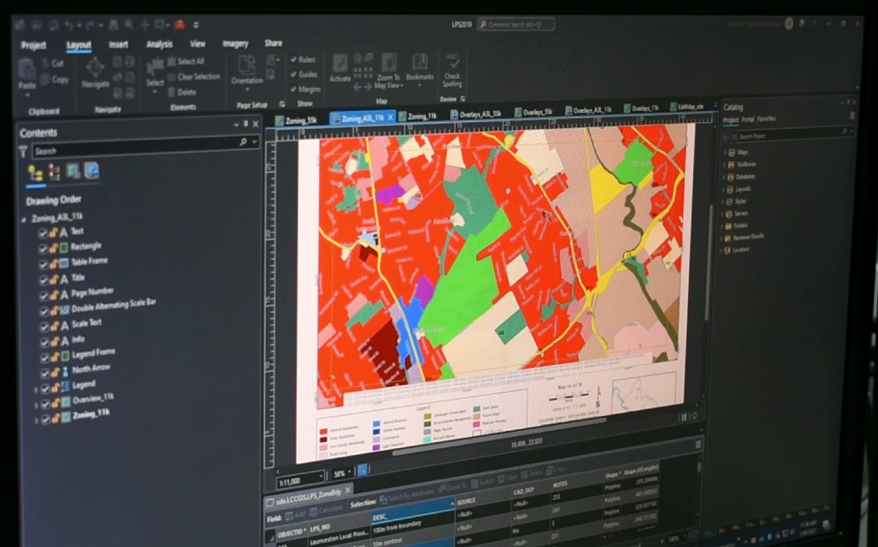
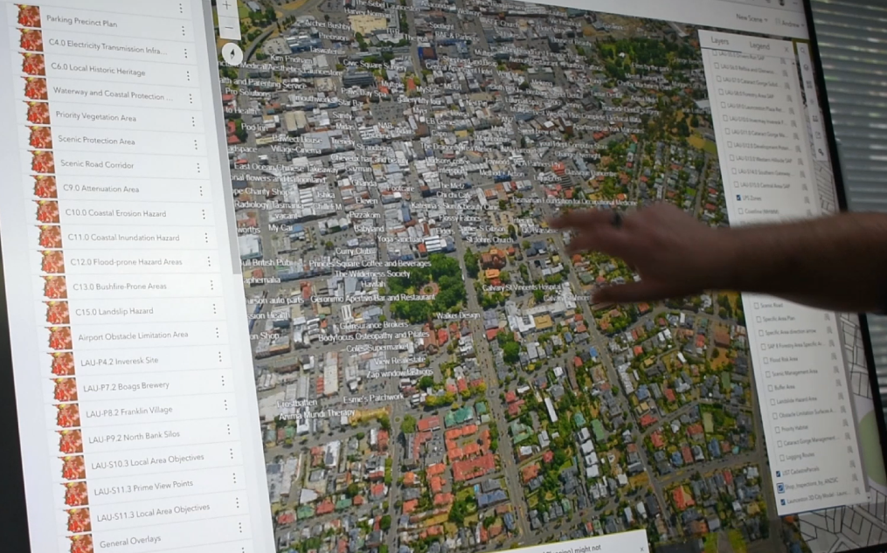
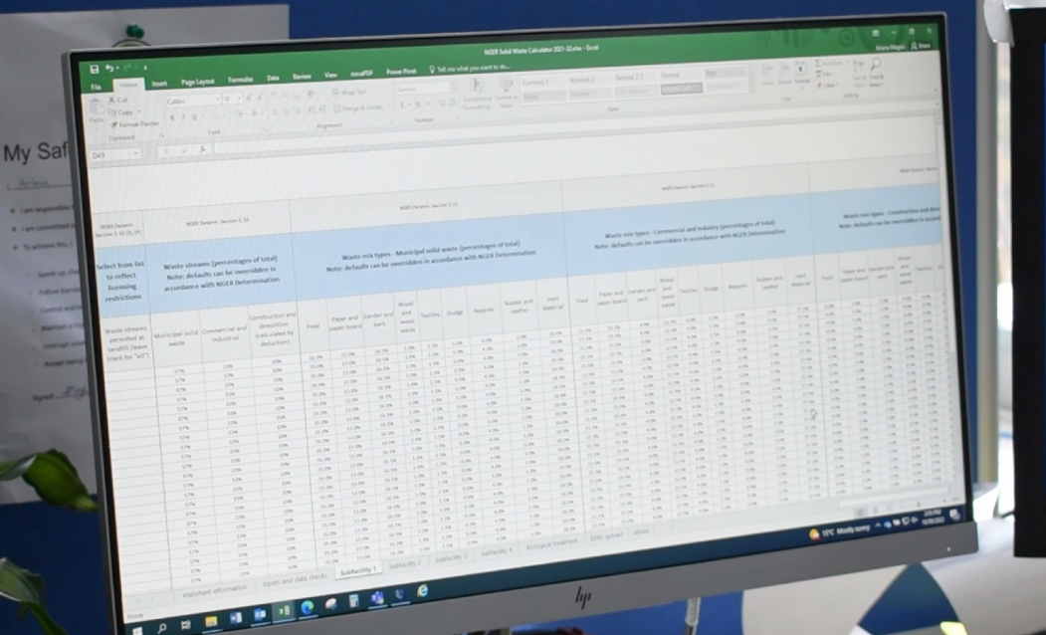
Information management practices

Slide 17
Keeping organisational history
Organisational benefits:
Enabling reviews of processes and decisions
Meeting legal and compliance obligations
Helping your organisation be more efficient, better organised, and effective

Slide 18
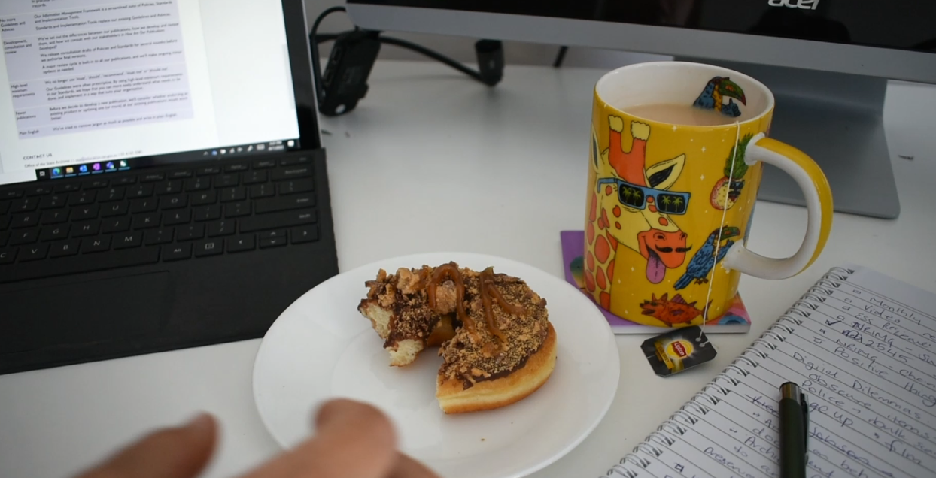
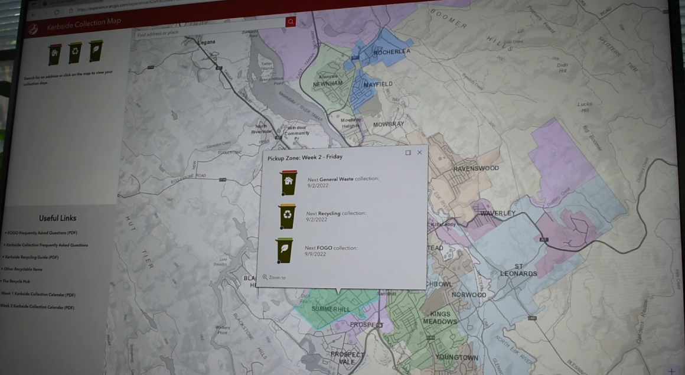
Information management practices

Slide 19
Good information management practices directly benefit the work you do and help you meet your legal obligations

Slide 20
Information management team contacts
Contact your organisation’s information management team for more information

Slide 21
License URL: www.creativecommons.org/licenses/by/4.0/legalcode
Please give attribution to: © State of Tasmania, 2023
Document Development History
Version | Date | Comments
1 | 10/11/2023 | Initial release

