Slide 1
Huon Valley Council
Recordkeeping and Legislation

Slide 2
Welcome
1-hour session
Website osa.tas.gov.au
Pre-Training
Exercise and Certificate

Slide 3
Objectives
To understand about
State/business records
What to do with a record after you have made it
Acts, standards and other tools and how they apply to your work

Slide 4
Session – Main topics
What we do and who we are
P-T (Pre-Training) Recordkeeping vs Information Management
What is a State record?
What is the purpose of a State record?
How long do you keep records for and the Record Lifecycle
P-T Technology One as part of your workflows
Why do you need to keep records
When the recordkeeping process begins
Where are records stored
Round Up – going through the exercise
If there’s time…or post-training material

Slide 5
Osa
What we do and who we are
Notes:
Office of the State Archivist

Slide 6
What we do and who we are
Statutory office in place to help the State Archivist meet the objectives of the Archives Act 1983 (Tas), we:
Issue a framework of policy and advice on the management of state and local government records
Develop and issue disposal schedules
Respond to client enquiries
Training
3.0FTE
For information and records management advice
Telephone: 03 6165 5581
Email: osa@libraries.tas.gov.au
Website: Office of the State Archivist (osa.tas.gov.au)

Slide 7
Pre-training check-in?
Recordkeeping vs Information Management
Notes:
sometimes the roles overlap

Slide 8
Recordkeeping vs information management
Key concepts I thought interesting: -
All records are information, but not all information is considered a record.
Both disciplines—recordkeeping and information management—can and should coexist.
In my own words I found that: - They share common goals related to the flow of information and accessibility, however, recordkeeping applies specifically to working with State records whereas information management encompasses a broad range of information processes
1accesscorp.com 2crownrms.com 3info.aiim.org 4crownrms.com”
Notes:
Now, I asked Bing Chat as AI is becoming a presence in our daily lives and your workplace will have its own policies on using it, but it’s a whole session on its own!
I like to think of recordkeeping as an essential function within the information management framework and associated workflows

Slide 9
training
What is a record?

Slide 10
what
Tasmania’s Act:
Our Archives Act 1983 (Tas) says a record is, ‘a document or an object that is, or has been, made or kept by reason of any information or matter that it contains or can be obtained from it or by reason of its connection with any event, person, circumstance, or thing.’
Easier
Any document or object, in any format, that is made and or sent to conduct business
Notes:
Here’s what our Act says… but this may be easier
The Act gives the State Archivist the power to issue policies etc., which he does in the form of Disposal Schedules, and policies and standards in our Information Management Framework

Slide 11
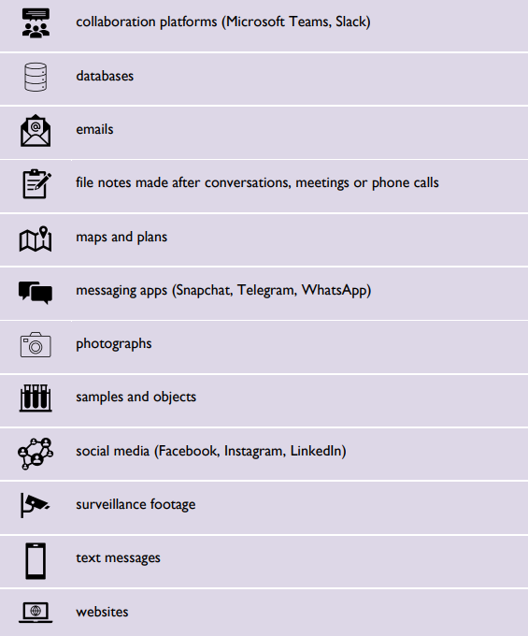
What
What are some records?
Any document with text, marks, figures, symbols, or perforations. It can be sounds, images, maps, plans, drawings, databases, objects, research data, minutes, photographs, social media, texts and so on.
Implementation Tool - Council Records: Advice for Councillors (osa.tas.gov.au)
Notes:
We do have some old planning scheme maps (these are slowly being digitised)
We also have a lot of photos from inspections.
Is there anything in this list that surprises you or that you didn’t know was a record?

Slide 12
What
The value and risk of a State record is determined by content and context
Example in Huon Valley Council
Consider: - An email sent to your colleague about a Huon Valley Hub, My Community, Arts and Culture grant is a record where the information contained within the email has value, e.g.
“Mr and Mrs Smith have applied for a grant, see attached, but feel they are at a disadvantage due to their lower income. Please advise.”
…while sending an email, to the same colleague, about how annoying it is that you must work on the ‘grant support drop-in workshop’ day because it’s your birthday, is not a record.
Notes:
The application for a grant is a record (might be via an online form) as is the email
Same topic - grant
Same format - email
Different context

Slide 13
What isn’t a state record
Implementation Tool - Council Records: Advice for Councillors (osa.tas.gov.au)
Notes:
Let’s talk more about what isn’t a record in the Huon Valley Council

Slide 14
What is a state record?
Some examples are
Minutes of council meetings
Social media posts with complaints from ratepayers
Decisions about the administration or management of the council
Rates notices
Emails to staff about work health and safety
Dog registrations and renewals
Planning submissions
Notes:
HVC have lots of emails that are State records:
Planning submissions
All notices – such as rates, dog licences, etc
Meeting minutes and agendas
Let’s check ‘what is a state record’ against what we learned is a record

Slide 15
Risk and value
Records may be considered in terms of risk and value. Most records that are kept permanently or long term are high value and or high risk. Let’s talk about value and risk.
High Risk – e.g. some infringement notices and minutes
Low Risk – e.g. some infringement notices
High Value – e.g. HVC invoices for over $100 000 and minutes
Low Value – e.g. Petty cash invoices for $100 or less
Notes:
Let’s have a go at figuring out the value and risk of some records
High risk and high value - highly confidential or classified records, records likely to be needed for legal purposes, commercially sensitive information, personal or sensitive information.
Dog infringements, Rates overdue notices, Abatement notices.
Building Applications/Approvals

Slide 16
What – let's check this against: -
Tasmania’s Act:
Our Archives Act 1983 (Tas) says a record is, ‘a document or an object that is, or has been, made or kept by reason of any information or matter that it contains or can be obtained from it or by reason of its connection with any event, person, circumstance, or thing.’
Easier
Any document or object, in any format, that is made and or sent to conduct business
Notes:
Here’s what our Act says… but this may be easier
The Act gives the State Archivist the power to issue policies etc., which he does in the form of Disposal Schedules, and policies and standards in our Information Management Framework

Slide 17
training
What is the purpose of a State record?

Slide 18
What
A record:
aids effective decision making
provides evidence for future and past events
helps you meet your legislative requirements and responsibilities
protects the rights and entitlements of ratepayers (makes the Tasmanian government accountable and meets community expectations)
Office of the State Archivist (osa.tas.gov.au)

Slide 19
What
Good recordkeeping also helps with: -
protects and helps defend against complaints or accusations of wrongdoing
makes robust and consistent decisions
promotes confidence in the authenticity and integrity of information
supports efficient and transparent business practices
provides evidence of business decisions, including your own
Office of the State Archivist (osa.tas.gov.au)
Notes:
We’re going to look at a couple of cases using our common sense to talk about them.

Slide 20
Scenario 1
Dog Registration and Digitisation

Slide 21
What Scenario
Dog registration (Pets and Livestock) and Dog fees and charges (Rates and Payments)
You process a form with data, send notifications, and file.
Payment is made based on rates for type of dog (hunting, guard, breeding dogs) and if de-sexed and or other reasons.
The scenario: - A hunting dog registration runs out and is renewed by a senior member as a guide dog.
Notes:
Now, while this scenario is a bit over the top let’s look at it and suspend our disbelief
Simplified workflow

Slide 22
What Scenario
Why could this be problematic? Discuss one or both of these
Historical reasons?
Legal reasons?
Notes:
Historical reasons –the record is kept for a historical trail of evidence if something goes wrong or if the dog is sold or abandoned at the Dog’s Home history that is was a hunting dog
Legal reasons - discuss why making hunting dog a guide dog could be problematic from a legal point of view?

Slide 23
What Scenario
Morphing into the digital
The senior member, who no longer hunts, mails you a paper record because they can’t use the online system. They explain that they want their hunting dog to be registered as ‘guide’ dog because they can’t see very well.
You may need to digitise the paper version. You might even be tasked with getting old records and digitising them.
Firstly, what practices do you use in your section? Paper based, digital or hybrid? How do you digitise?
What quality do you scan to and where do you find that information that guides you to scan correctly?
Digitisation Toolkit – Office of the State Archivist (osa.tas.gov.au)
Notes:
Adding to our scenario of a hunting dog being transitioned to a guide dog…
For court – it needs to be clear but is admissible as long as we print it.
HVC example - Had a court case recently about unpaid rates – so need to be able to provide evidence that this is the case. The data is electronic in ECM and Pathways and so we need to print clearly so it can be read and provided to the magistrate to support our case.

Slide 24
What Scenario
View - Tasmanian Legislation Online
Notes:
It’s here we begin to talk more about Acts. For the case we just discussed the Dog Control Act 2000 is mentioned on your website and is relevant to dogs only. We’ll look at some terms first found on this image and to do with how laws are made.

Slide 25
What Scenario terms
Act: A law made by Parliament, also called a statute. An Act starts as a Bill and becomes an Act once it has passed both Houses of Parliament and received Royal Assent.
Parliament: A group of people with the authority to make laws for a country or state. The Parliament of Tasmania consists of the Governor of Tasmania, the Legislative Council and the House of Assembly.
Legislation: A law or laws passed by Parliament.
[Statutory: required, permitted, or enacted by statute (which is a written law).]
HAEO-Glossary-of-Terms.pdf (parliament.tas.gov.au)
Notes:
Let’s look at a couple of terms first before we launch into the next scenario

Slide 26
Scenario 2
Tenders and Legislation

Slide 27
What Scenario
Notes:
Now, the next case
Example case. Your Council, Tenders and Expressions of Interest. You have a code and procedures for tenders and contracts.

Slide 28
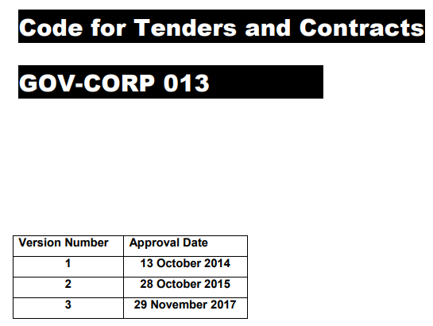
What Scenario
Notes:
Show PDF – even though the date is 2017, version control is a good recordkeeping practice. Because you can see this document needs to be renewed.

Slide 29
What Scenario
Morphing into legislation
The two documents embed legislation – acts and regulations relevant to the tender and contract workflow.
Procedures-for-Tenders-and-Contracts-October-2015.pdf (huonvalley.tas.gov.au)
Notes:
While your internal documentation embeds legislation the overarching Archives Act dictates what happens to documents that are created as a result of your internal workflows.

Slide 30
Breaches
You have responsibilities to report data breaches to several authorities, and it is also good practice to report even when it is not a statutory requirement.
Our Information and Records Standard Information and Records Management Standard (osa.tas.gov.au) sets out your requirements. For example, you may need to report to the: -
Tasmanian Government Chief Information Officer
Tasmania Police
Integrity Commission
Ombudsman Tasmania
Office of the Australian Information Commission (OAIC) and
to us, the Office of the State Archivist.
Notes:
Now I was informed that we can’t really provide training as such on breaches and some act that aren’t to do with recordkeeping directly but I’ve included a bit of information at the request of Patty and Belinda provided by my team members.
Depending on your role you may just be directed by your team supervisor
Can you name any recent breaches?

Slide 31
rti
Right to Information Act 2009 (RTI)
“The RTI Act provides access to information, not just records. This means that every email or teams message you send is accessible under RTI. Think carefully before creating a record to ensure it is accurate and you will not be embarrassed by it later.” Manager of OSA, 2024
Retention and Disposal – Office of the State Archivist
Notes:
RTI is mentioned on every Retention and Disposal Schedule which are found on the OSA website – we’ll go into these a little in the next section ‘Lifecycle of a record’
You could draw attention to the introduction to the schedule which states that you can't destroy records (even if the retention period has passed) if there is a RTI in progress.
Please note that we can only provide basic info about PIP and RTI Acts because they are not our legislation. We need to be clear that they are administered by the Ombudsman and specific questions need to be referred to them.
Also, that the council will have a process for obtaining legal advice, so that would be their first point of call.
The screenshot, has some information that appears in our RDS which tells a Tasmanian Government organisation when to destroy records

Slide 32
pip
Personal Information Protection Act 2004
Retention and Disposal – Office of the State Archivist
Notes:
PIP is mentioned on every Retention and Disposal Schedule which are found on our website. Under the PIP, people have a right to access and amend their personal information held by the council free of charge.
But what if we look at this in a different way…
During the course of my employment when working with paper records I would think about a client’s privacy, so if I left my desk but it was in view I might turn the paper over or put something on top, when I went out I would lock up the records. What is the equivalent today with digital records? How do you protect a person privacy?

Slide 33
training
How do we know which records to keep and for how long? And how does it all fit into the lifecycle of a record?

Slide 34
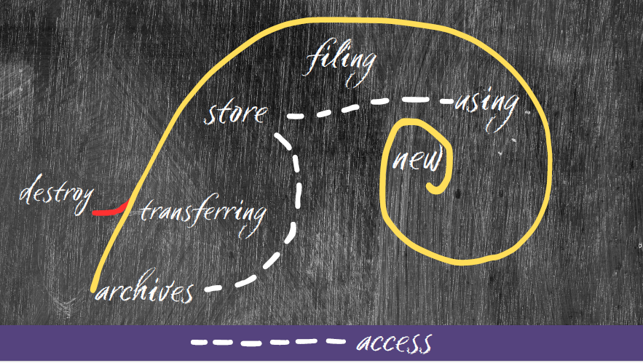
When
Notes:
Here’s a fancy diagram I made of the Golden Spiral showing the overarching recordkeeping lifecycle
Filing vs storing – filing as a working record with store as a more permanent location
Go through workflow and then stop at the junction of destroy or transfer – this might be where you assist an info manager but you may be required to access a record, use it again, and then store etc.
What an information manager might do is look at the ‘store’ part and manage a database or work out what data needs to be migrated to a different system or if the storage of hard or soft copies is still up to date and so on
The other thing is records may be created along the journey – someone needs to fill out a form to access an archived record!

Slide 35
Record lifecycle
Legislation tells you to do a certain thing or follow certain ways > you possibly make a record because of that > legislation sometimes tells you how long to keep it
Legislation (Local Government Act 1993 (Tas)) outlines record content and context> You make a tender record > Ends with legislation telling you about disposal (Archives Act 1983 (Tas))
Notes:
The next slide has a visual on the lifecycle of a record to do with tenders
If the record doesn’t originate with Huon Valley Council then there is no need for you to keep and or manage it – Belinda?

Slide 36
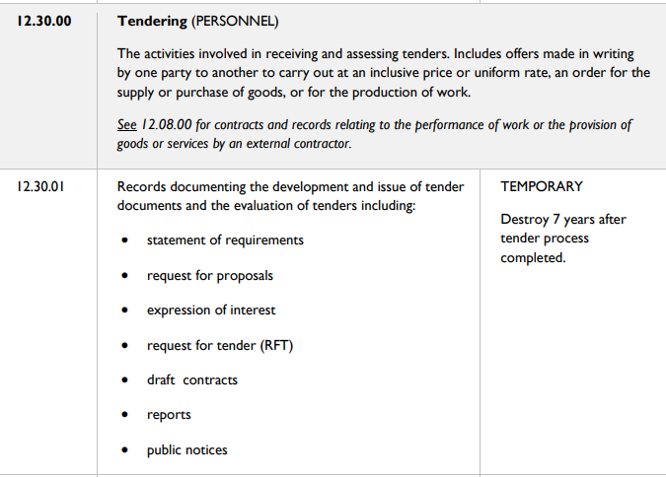
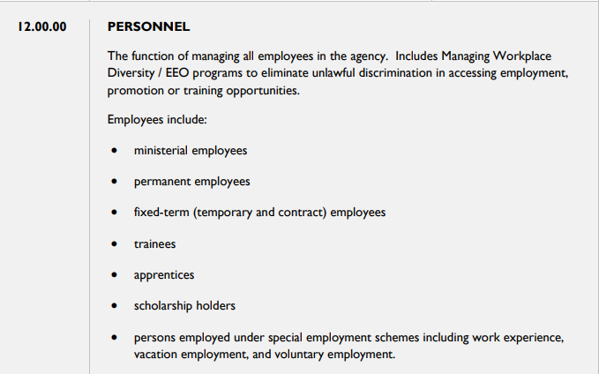
act-1993-095 (legislation.tas.gov.au)
Procedures-for-Tenders-and-Contracts-October-2015.pdf (huonvalley.tas.gov.au)
DA2157-Common-Administrative-Functions.pdf (osa.tas.gov.au)
Notes:
So here’s the lifecycle in action – in your procedures it talks about inviting tenders, how that is communicated e.g. via email, and then the Retention and Disposal schedule, which is a whole training session of itself, includes when those may be disposed (transferred or destroyed)

Slide 37
Record lifecycle
Retention and Disposal Schedules: -
Records of continuing value, such as permanent records, are available to the public and government for appropriate lengths of time
They manage routine disposal of short term or temporary value records without having to seek authorisation from the State Archivist
They may be developed to meet the unique needs of an organisation
RDSs begin and end a record’s lifecycle.
Retention and Disposal – Office of the State Archivist
Notes:
Show an RDS with the terms and explanation parts

Slide 38
Record lifecycle
Some terms
Permanent records are those that will be transferred to the Tasmanian Archives to be retained as State archives. The Archives Act 1983 (Tas) establishes 25 years as the maximum required timeframe for the transfer of permanent records to the Tasmanian Archives unless an extension of time has been approved by the State Archivist.
Temporary records are those that can be destroyed under the authority of this schedule after a minimum retention period, or once certain requirements have been met.
Retention and Disposal – Office of the State Archivist
Notes:
So, what you need to know here is don’t delete records before checking!

Slide 39
how
Good news
The good news is that usually organisations like OSA provide advice to support government organisations on record disposal.
Government organisations usually have information management teams who in turn can ensure procedures are in place for staff.
Notes:
The State Archivist provides this advice

Slide 40
how
DA2200 example
Retention and Disposal – Office of the State Archivist
Notes:
We have covered a scenario about dogs’ registration and here is the disposal schedule for the records – this completes the lifecycle of a dog registration

Slide 41
Pre-training check-in
Technology One

Slide 42
Technology one
Filing
Filing is critical because one of the purposes of a record is that it must be accessible. Remember the Archives Act!
Discussion
Notes:
Tell me what you use Technology One for. Consider some or all of these: -
When you file in Technology One what naming conventions do you use? Why is it important to use the same way to name files and folders? (i.e. access).
Optional. Also, where you put your digital files is critical – while Technology One folders will/do have the ability to put a classification assigned to a folder i.e. 5 years retention, you need to put the file in the right classified folder. (You may want to leave this question for after the session!)

Slide 43
training
Why do we need to keep records while we dispose (transfer or destroy) others?

Slide 44
Why
We keep records for access, historical purposes, to track decisions or processes, legal reasons, to protect ourselves, our organisation and or our clients
We dispose (transfer or destroy) of records when they have reached their retention period, and they are no longer needed for business purposes

Slide 45
Why
Activities
Access – clients want to see the records over time for Huon Valley’s reducing food waste – other examples
Historical – researchers want to know what weeds have existed in the Valley – other examples
Legal – to prove something was paid - other

Slide 46
Why
Rounding out with Standards
Documents that guide, set out terms, and or are procedural in nature to make sure products, services and systems are safe, consistent and reliable
Information Management Framework – Office of the State Archivist (osa.tas.gov.au)
Notes:
We are now going to round our learning out with Standards We’ve looked at Acts, codes and procedures,

Slide 47
Why
If a record is
Any document or object, in any format, that is made and or sent to conduct business then
Legislation may direct you to create a record
A standard may guide how those records should be kept
Legislation may tell you how long to keep those records
Notes:
Let’s put this together to make an information management workflow

Slide 48
Why
So, a record here is
An electronic document that has been made to conduct business
The Dog Control Act 2000 (Tas) tells you and your client that dogs over 6 months must be registered
A storage standard may tell you where you can keep the records
The Archives Act 1983 (Tas) via an RDS 'tells' you how long to keep the record (we’ll talk a bit more about this shortly)
Notes:
Show Storage standard on the website or is there an internal policy or procedure at HVC?
3 years vs 10 years
In terms of records, dog registrations are covered in DA2200 / 01.08.00. Registrations for all dogs, except dangerous dogs and companion animals are kept for 3 years. Registrations of dangerous dogs and companion animals are kept for 10 years.

Slide 49
training
When do we begin the recordkeeping process?
Notes:
Straight away is best – as soon as you make or receive a record

Slide 50
When
Some records – such as those in workflow or other business systems are automatically created for you. At other times, you must make a conscious decision to make or keep a record. Do so if you need to show:
what happened, when it happened or who was involved
what was decided or recommended and by whom
what advice or instruction was given
the order of events or decisions.
Keep the Knowledge Make a Record (osa.tas.gov.au)
Notes:
Guidance to when

Slide 51
When
If you are not sure, ask yourself:
Did I write, send, use or keep this in the course of my work?
Am I (or is someone else) required to act on this?
Will this information be needed in the future? If you answer ‘yes’ to any of these questions, you should make or keep a record
Keep the Knowledge Make a Record (osa.tas.gov.au)

Slide 52
Scenario 3
Reporting page

Slide 53
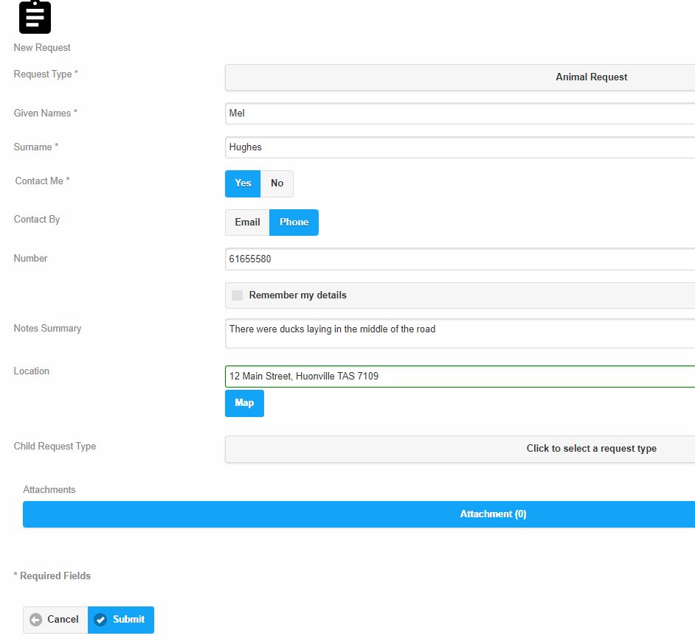
Notes:
Let’s apply the workflows to one of your reporting pages. So there’s going to be a kids and their dogs parade down main road in Huonville but there are ducks lying in the middle of the road.
Someone fills out your form
If your system has churned out a record. You get the notification and you have to do something with it. You might have to send out one of your contractors to clear the road and they’ll need to make a record and give you a copy.
Thus, the bottomless pit of records.
Let’s check – is it a record?

Slide 54
When
Any document or object in
Any format
That is created by you or your organisation to conduct business
or
That is received by you or your organisation to conduct business
Notes:
Let’s measure this against what we know now
So, yes, it is a record
Belinda – what would you say about the online form as a record? It all depends on the context of the record. All the online records are kept in our Pathways System and responded & actioned within the same system. If there is anything serious then additional records would be produced that would then end up in ECM as a record.

Slide 55
appraisal
OSA has an appraisal statement for state records required as state archives.
Let’s appraise these two records. We’re going to ask do we think this is important, why and how long shall we keep it for?
Record 1. Minutes of a meeting that included discussions about the senior member who tried to register his hunting dog as a guide dog
Record 2. Form for petty cash - filled out incorrectly
Information Management Framework – Office of the State Archivist (osa.tas.gov.au)
Notes:
This part ties in with a few of the sections within this training – it’s about WHEN a record gets its ‘lifecycle’ credentials
At some point the business activities you carry out every day the records you work with would have been ‘appraised’ – that is to decide which ones should be created and how long for them to be kept. The appraisal process is planned and documented. It is the ‘cornerstone’ to decide which records become a part of the State Archives for the future. – these are the ones that often sit in the Tasmanian Archives and showed you some images or my investigation into our archives
Record 1. Minutes of a meeting that included discussions about the senior member who tried to register his hunting dog as a guide dog – high value high risk permanent?
Record 2. Form for petty cash - filled out incorrectly risk value low risk temporary?

Slide 56
training
Where do we store our records?

Slide 57
Where
On our desks/desktop initially, then they might be filed into folders in cabinets/servers/clouds.
That’s the easy answer.
Where is important because it is part of the ‘Preservation’ process with recordkeeping and archiving. If records are born digital, you still need to think about where they are stored.
Notes:
Patty said this is enough info on preservation with slide 70 and We will not keep hard copy records if we have them digitised.

Slide 58
Where
There are several things to think about with storing new records. Records may be paper or stored on disks or on servers (cloud). Formats will impact how records are kept.
Environment – light, humidity, liquids, temperature
Security – secure, are they backed up, are they easily accessed if needed
Space and cost – this is usually one of the biggest considerations as space and cost become the limiting factors when keeping records
Notes:
Belinda mentioned that you use Zirco Data
Most records are digital or being digitised but it doesn’t matter… all these points still apply but you just don’t ‘see’ them
The next slide is going to show you where some of your old records are found

Slide 59
Notes:
Here are some paper records from the good old days
I did a search in our LT catalogue under Tasmanian Archives for some admin files
Now, I can see these records have ended up in the Tasmanian archives but they could end up with another council or organisation

Slide 60
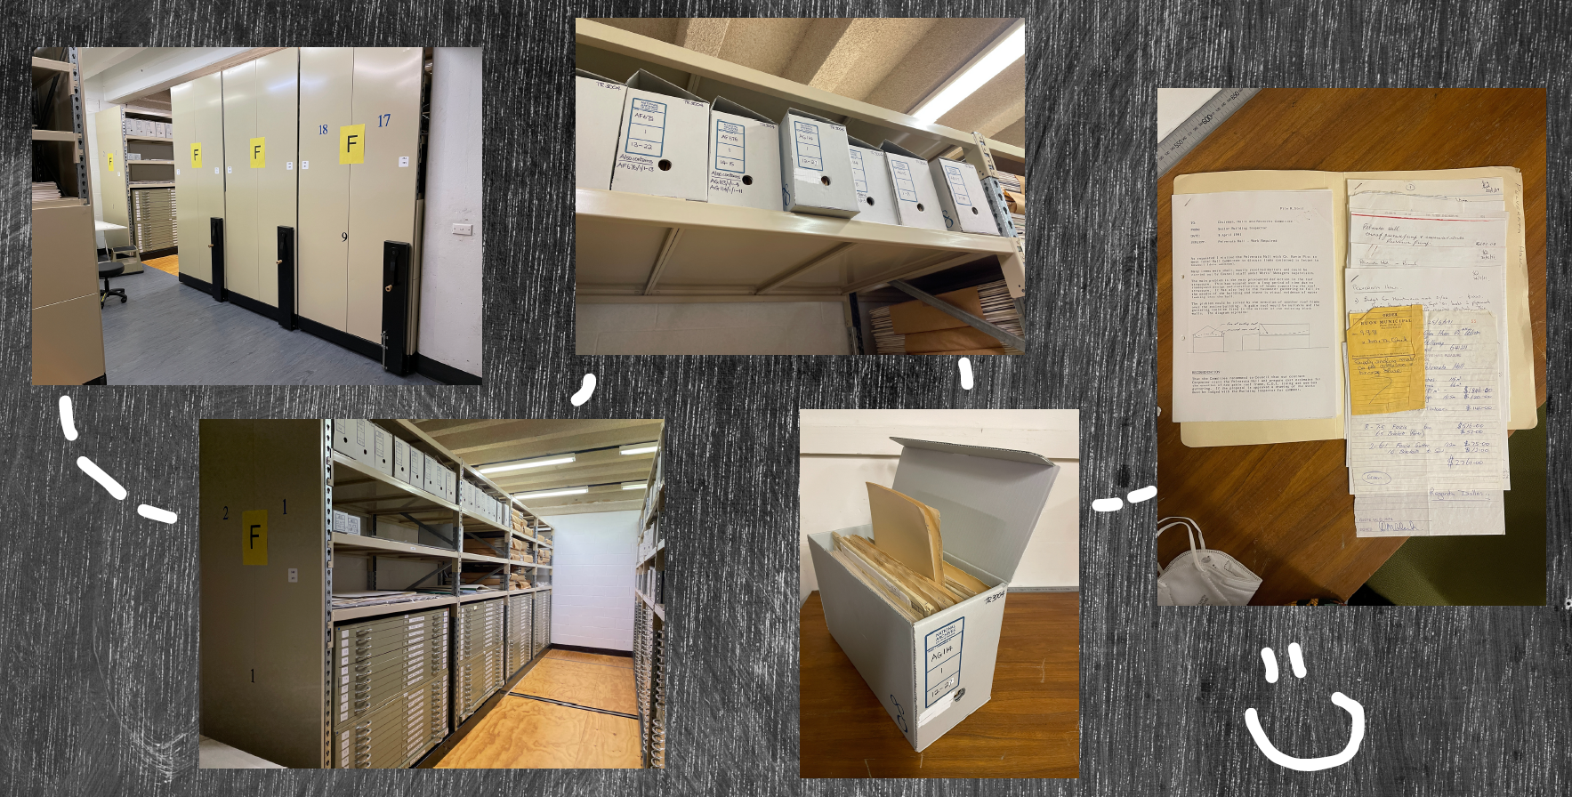
Notes:
This is a very physical process based on paper – 91 Murray Street (not just a library we have floors of archived material)

Slide 61
Round up
Exercise
Notes:
Instead of doing a summary you'll have this presentation to use – I'm going to get you to apply your knowledge.
For your Post Training exercise, I would like you to create one ‘Round Up’ that is relevant to you. Once I receive it (and you can check it with Belinda or myself) then I’ll send your certificate.

Slide 62
The Archives Act 1983 (Tas) informs you that
a record…
(which is any document or object
in any format)
That is created or received by you or your organisation to conduct business and
is used to conduct business as further defined by a specific Act and
A Standard might tell you how to look after the record and it
…will be appraised and your organisation will be directed by the State Archivist and his team regarding how long to keep the record and how to dispose (delete or transfer)
Notes:
You are going to take this ‘outline’ and fill in the necessary parts with a record you use as part of your work
Via email, and I’ll send out your certificates

Slide 63
The Archives Act 1983 (Tas) informs me that
my record…
Is created when I receive instructions how to buy a book from an independent author
via email
And that record to conduct business is further defined by the Libraries Act 1984
And the Information Management Standard tells me I need to keep my email, and internal policies tell me to store my email in CM and it
…has been appraised and my organisation will be directed by the State Archivist and his team regarding how long to keep the record which is considered under DA2158 Short Term Value Records and I can destroy the email when reference ceases (normally sits in a folder in CM with a temporary classification)
Notes:
Example of one of mine when working in Heritage collections
Pick a record, decide what act informs you, what legislation defines it, if there is a standard, and what RDS might apply
Email me, and we could do a quick catch on teams

Slide 64
Thank you
For information and records management advice
Telephone: 03 6165 5581
Email: osa@libraries.tas.gov.au
Website: Office of the State Archivist (osa.tas.gov.au)
Notes:
Feedback on the content, depth and pace please as this was a trial – I’ll send out an email and you can reply to this. At the moment I’m not asking for feedback on ‘me’ as it’s been a few years since I’ve presented.

Slide 65
Post-reading and If there’s time…

Slide 66
Can I delete this record?
Discussion
Often it is dependent on if it is a short or long term record. Have we made a temporary record by printing off a digital form to work on it, before updating the online version? Or maybe we’ve made a digital copy and working on that.
Have you ever done this and is it ok to get rid of your working copy?
If you’ve captured everything then might be okay but what if you’ve made a lot of justifications on your working copy. You may decide to protect yourself and keep that copy as a State record. Then you need to ask if it is safe, is it secure? Does it have personal information – this is when you need to apply knowledge of legislation.
Notes:
Can you add in your notes, that they should have an authorised disposal program with policies and procedures that set out what they can dispose of, and who has to authorise that disposal, and that disposal is documented in the council's Register of Records Destroyed (RRD). This is their proof that records have been destroyed legally.

Slide 67
Post reading
Suggested post reading and sites to visit: -
https://www.osa.tas.gov.au/implementation-tool-legal-admissibility-of-records-fact-sheet-2
The Evidence Act 2001 (Tas) and the Electronic Transactions Act 2000 (Tas)
Personal information protection | Tasmanian Government (www.tas.gov.au)
View - Tasmanian Legislation Online
Ombudsman Tasmania

